Slide 1

http://www.future-eg.com
Futures company
ODOO
ERP PROJECT

Slide 2



OUTLINES
01
our Team
02
Overview
03
challenges
04
Solutions
05
06
Modules
contact

Slide 3






Our Team
Mohamed nasser Mohamed fayed
Aya Mohamed Mahmoud
Ahmed abdelrahman ahmed
Esraa mohamed elmatbouly
Mohamed samir fathi sariya

Slide 4

Overview
Business Plan
Futures seeks to expand its presence in the low current systems market by growing its client base across key sectors and improving operational efficiency through better inventory management, quality installations, and strong after-sales support. Partnerships with technology leaders and continuous staff development are central to its growth.
Business Goal
Futures aims to lead the low current systems market in Egypt and the region by achieving sustainable growth through innovation, customer satisfaction, and operational excellence.

Slide 5
challenges
System Setup and Financial Configuration Issues
Loans, Payment Terms, and Customer Management Issues
No structured accounts for loans (long-term, short-term, and interest), and manual recording of monthly loan installments, increasing the risk of errors.
No clear opening balance, invoice layouts were unclear, payment terms were rigid without incentives for early payment, and no customer follow-up system was in place, resulting in delayed collections.
Missing basic company information (name, address, tax number) and lack of branding (logo and watermark) on invoices, leading to unprofessional documentation.
Fiscal localization settings were not aligned with local tax laws, stock valuation was manual causing accounting errors, Anglo-Saxon accounting was not activated, fiscal periods were undefined, and currency rates were not updated automatically, exposing financial reports to inaccuracies.
Lack of Product Traceability
Stock Discrepancies and Excess Inventory
There is difficulty in tracking product expiration dates, monitoring delivery and receipt delays, and locating specific items within the warehouses. This leads to operational inefficiencies.
There is a mismatch between the actual physical stock and the recorded stock balances. This causes overstocking and negatively impacts both financial and operational performance.

Slide 6
challenges
Purchase Agreements
Sales Flexibility Enhancement
Established purchase agreements with multiple vendors to secure fixed pricing for a defined period, and implemented a price comparison process to optimize supplier selection and reduce procurement costs.
Created tailored price lists for wholesale and corporate clients, implemented dynamic discount programs by period, and categorized products into on-demand and optional items to enhance sales flexibility and customer satisfaction.
CRM Optimization
HR Challenges and Solutions
Salespeople often struggle with tracking leads, opportunities, and quotations, leading to lost sales.To solve this, I developed a CRM module in Odoo ERP.
It helps manage leads, opportunities, sales teams, pipelines, contracts, and quotations.
This solution the efficiency and improves sales outcomes.
We faced difficulties in managing of our workforce, including hiring, attendance, time off, salaries, and employee management.so we implemented Odoo ERP modules such as Recruitment, Attendance, Employees, Time Off, and Payroll.to improve our HR and administrative processes effectively.

Slide 7


FUTURE COMPANY
Solutions
We implemented a customized Odoo ERP system to integrate and automate accounting, inventory, sales, purchases, HR, and CRM. Fiscal localization was configured to match local tax rules, and Anglo-Saxon accounting was enabled for accurate cost tracking. Assets like vehicles, furniture, and IT equipment were managed through automated templates. Loan management was set up with automated entries and flexible payment terms. Follow-up reminders were also created to improve customer payment collection and cash flow

Slide 8
Configuration and
Accounting

Slide 9
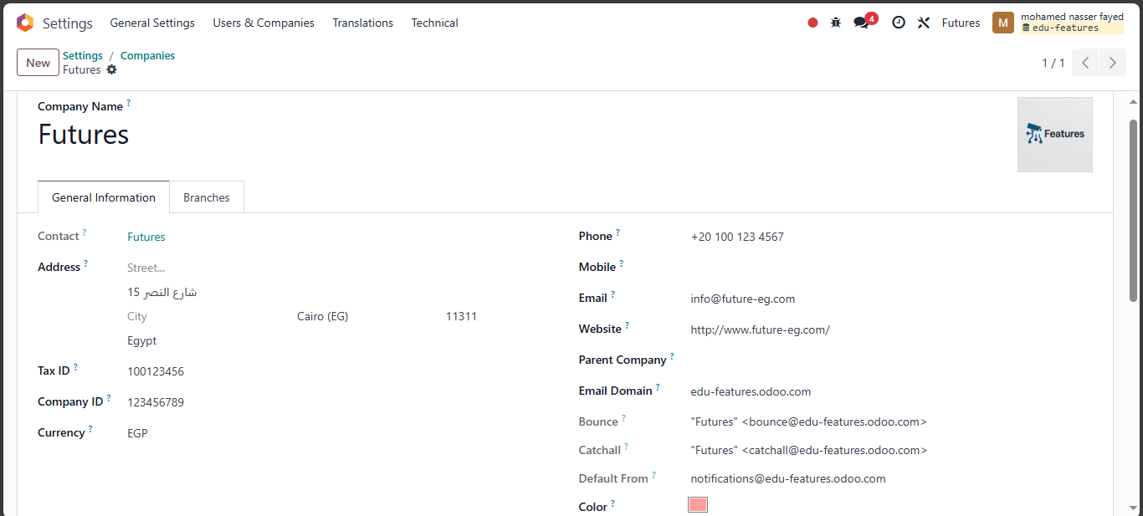
Company Details

Slide 10
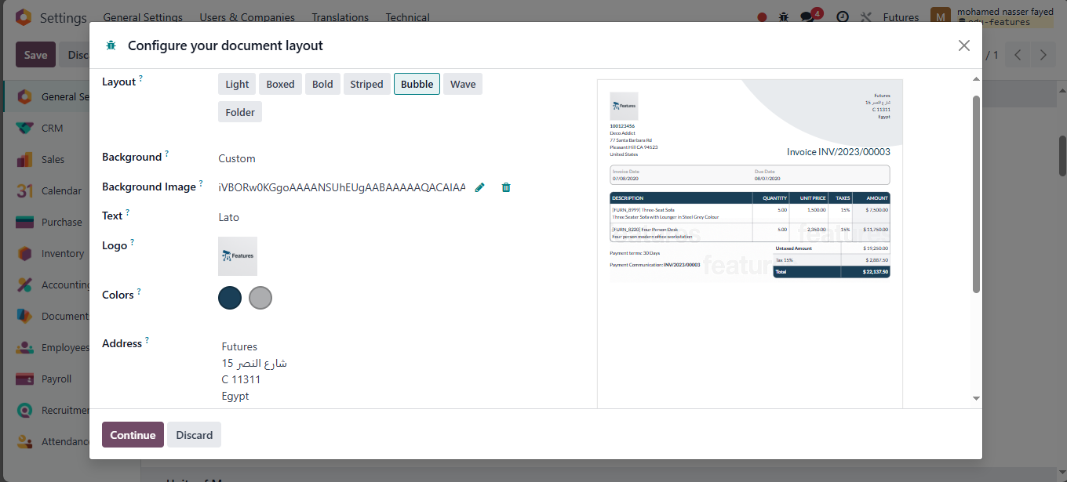
Document Layout

Slide 11
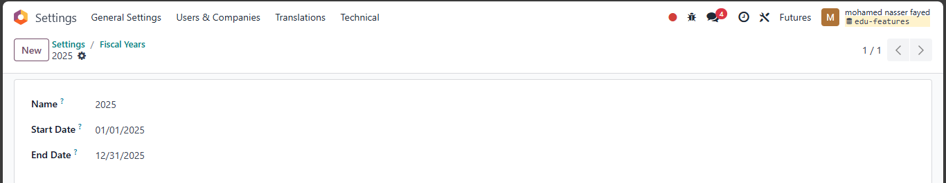
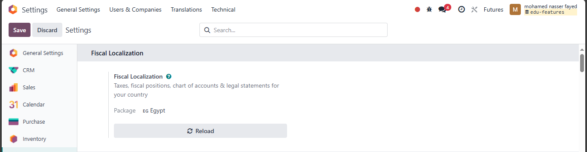
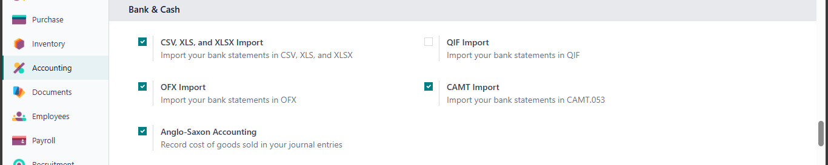
System Basics

Slide 12
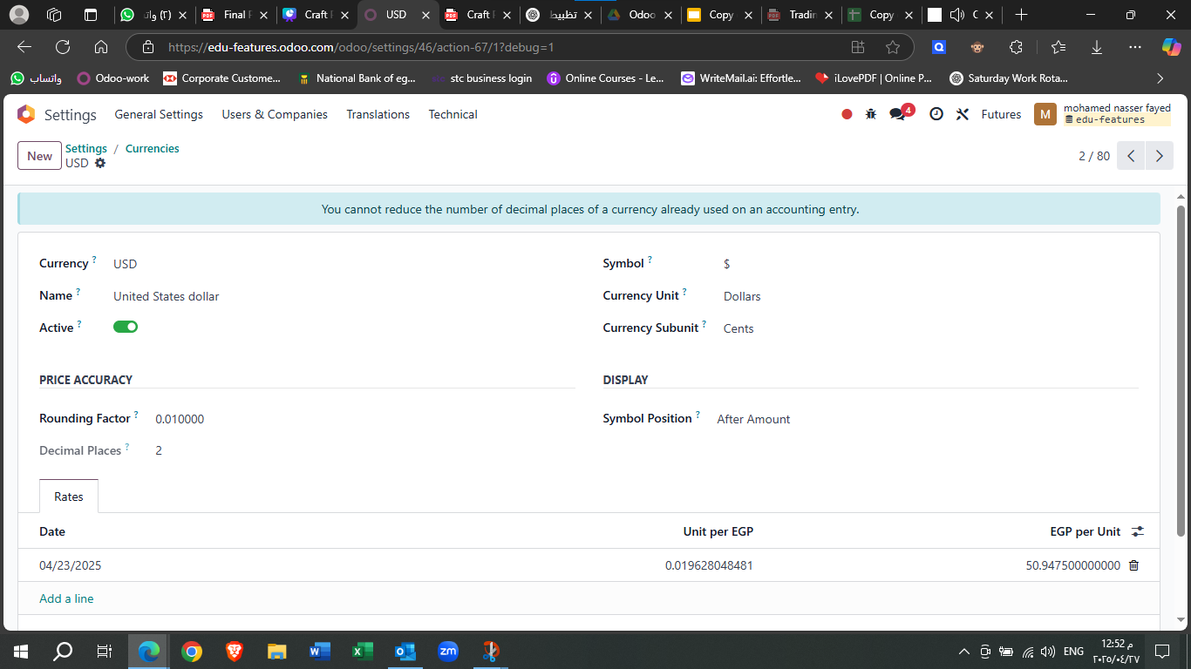
currency

Slide 13
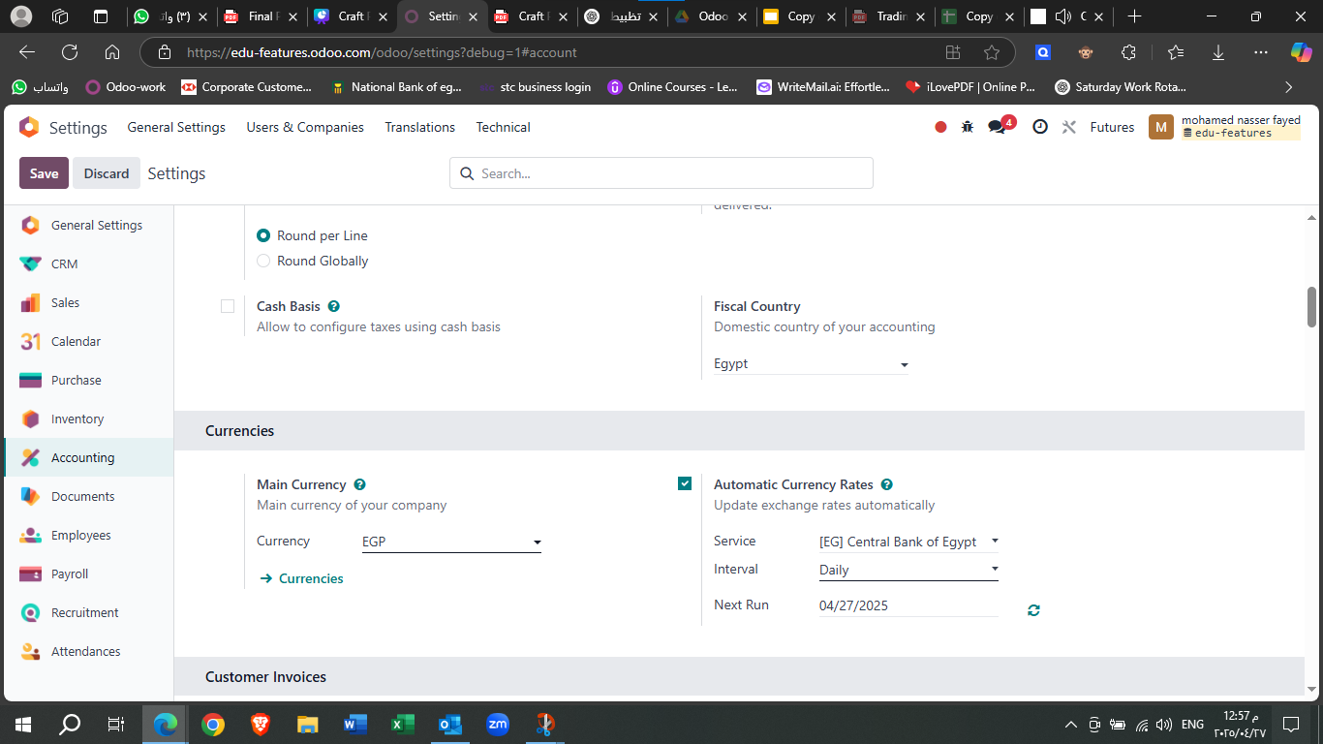
currency

Slide 14
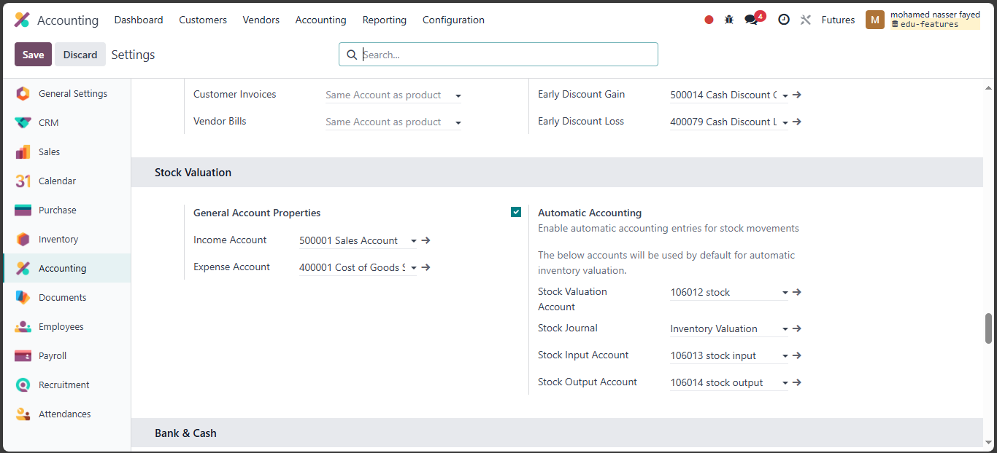
chart of ACC

Slide 15
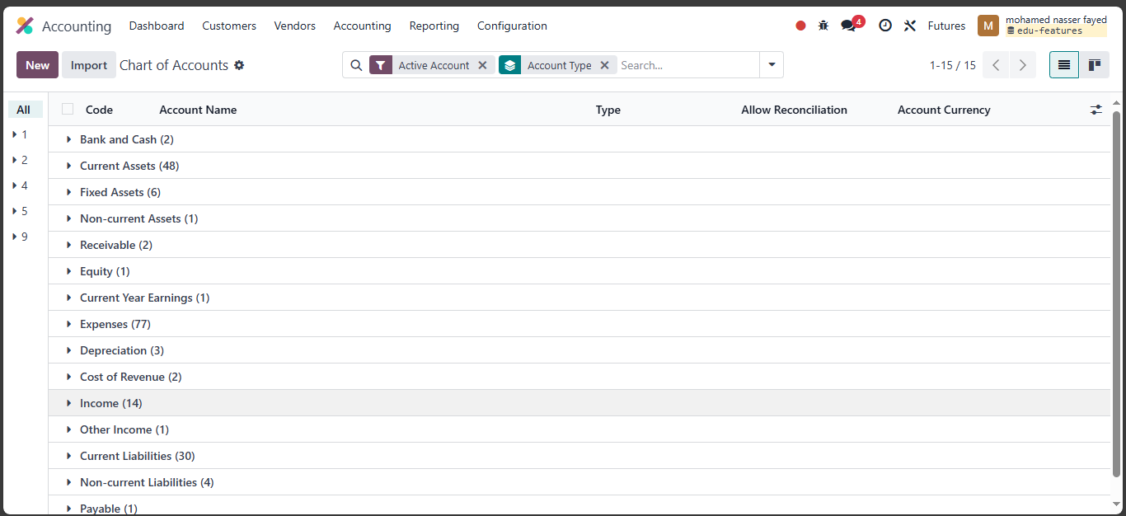
chart of ACC

Slide 16
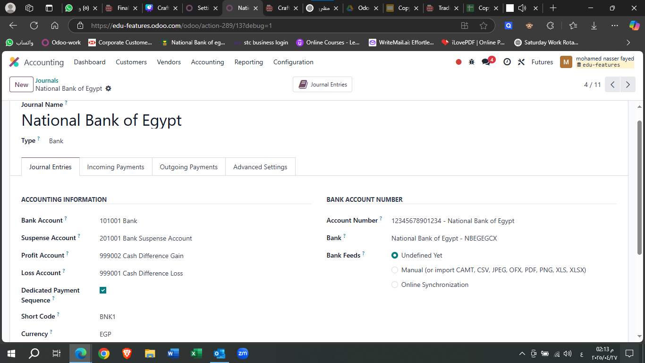
Bank

Slide 17
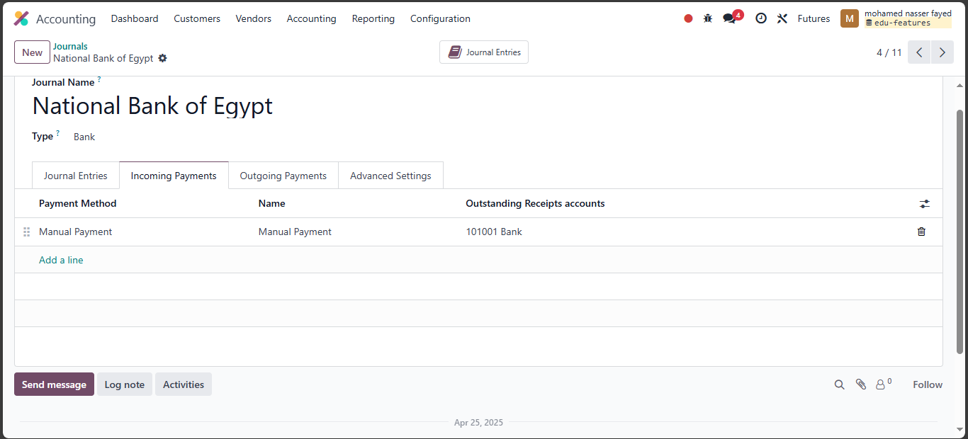
Bank

Slide 18
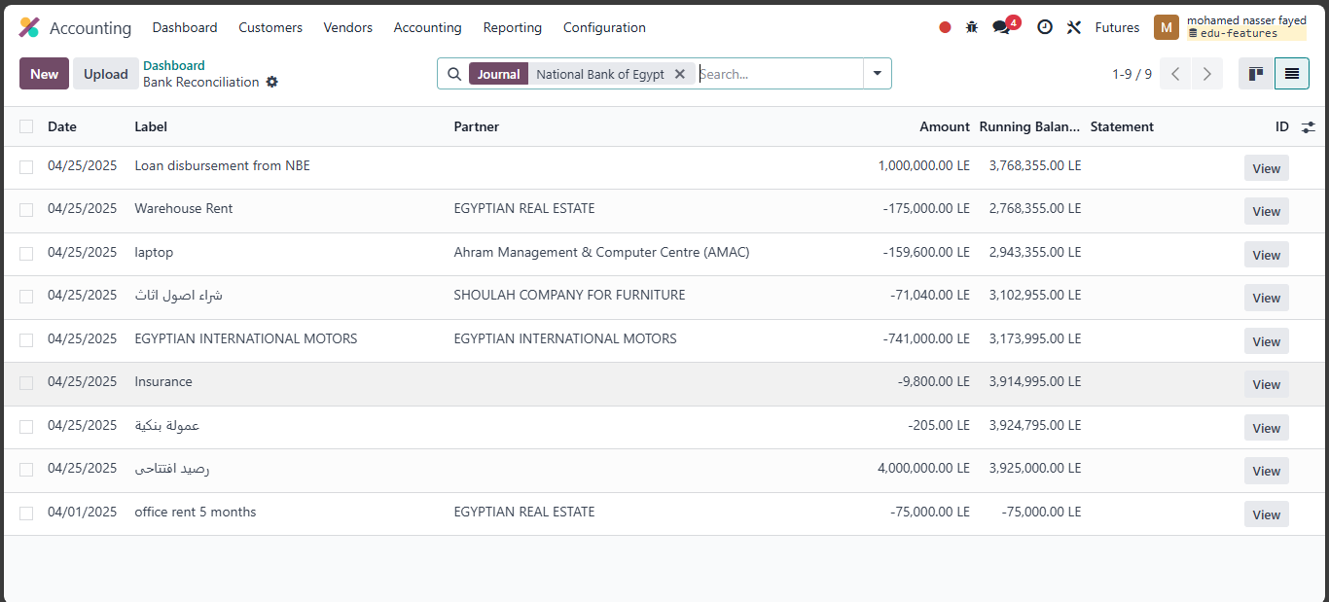
Bank Reconciliation

Slide 19
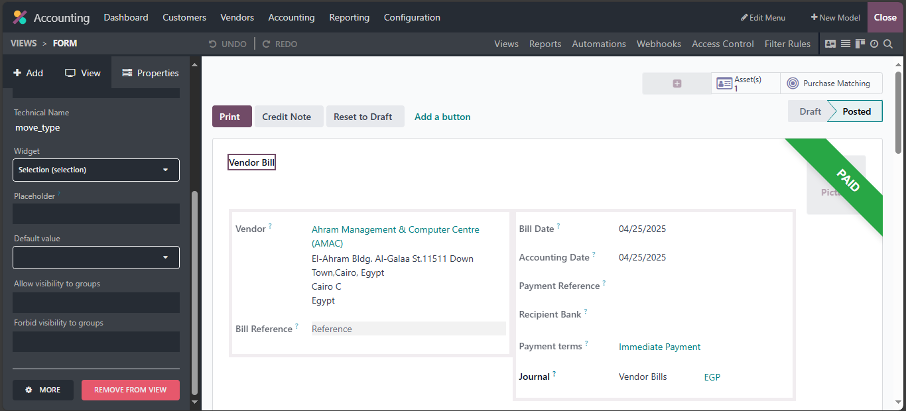
studio

Slide 20
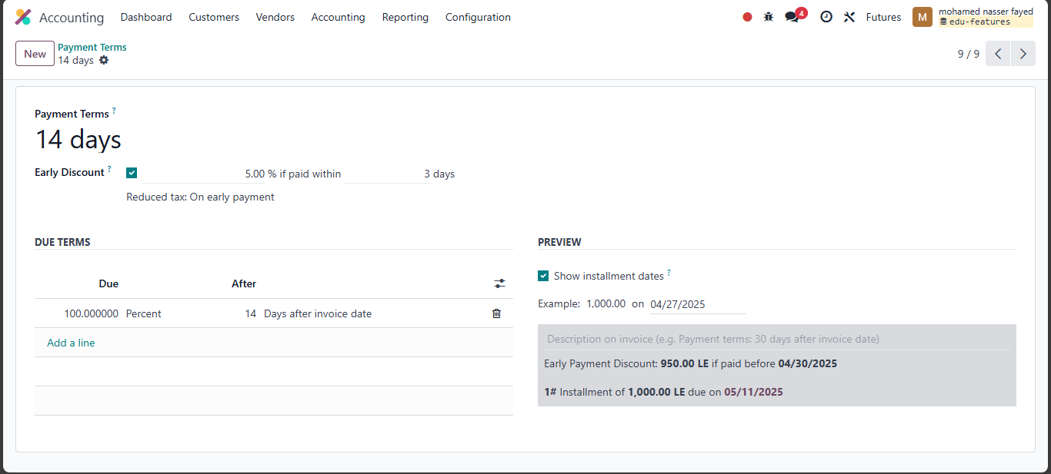
Payment Terms

Slide 21
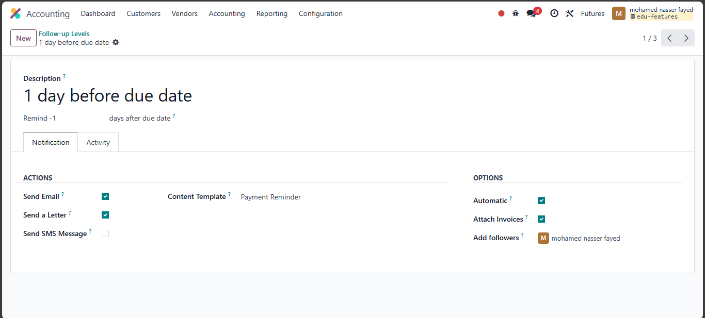
Follow up levels

Slide 22
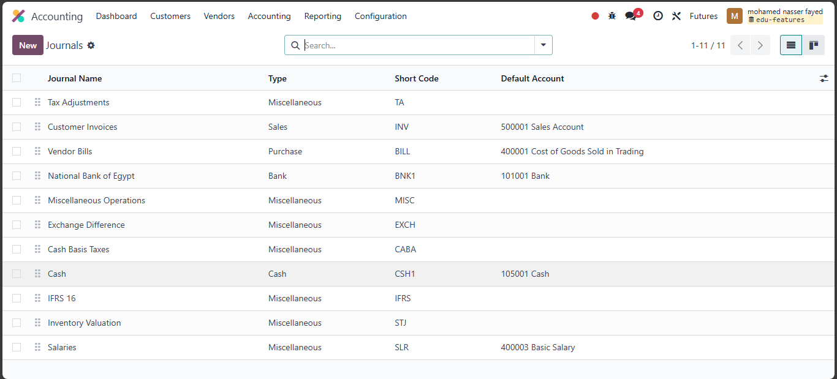
journals

Slide 23
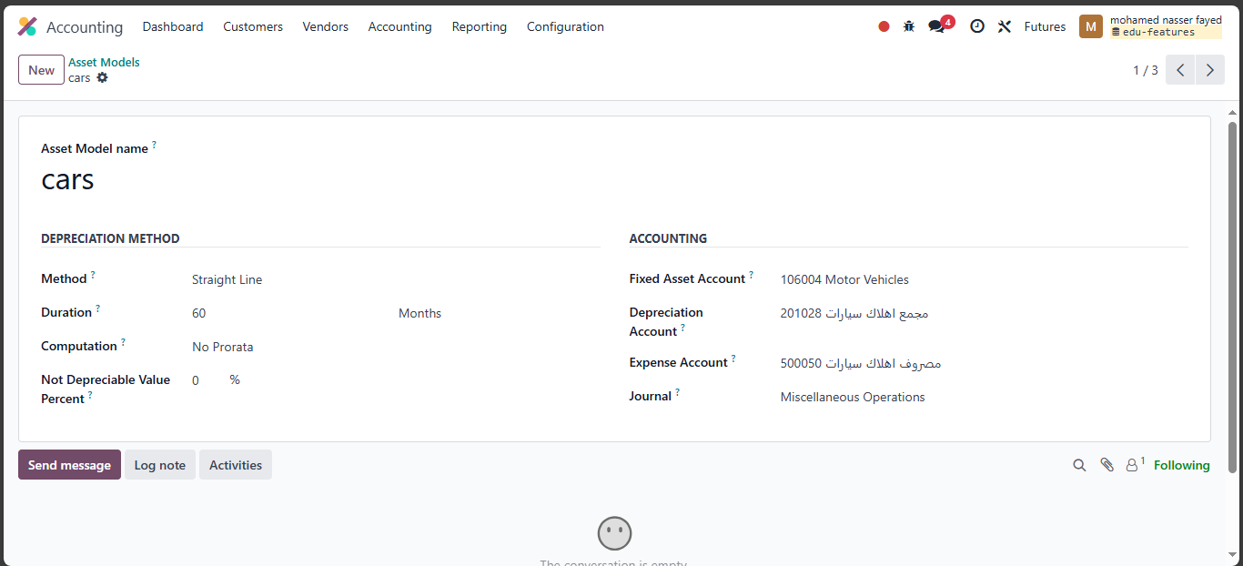
Assets

Slide 24
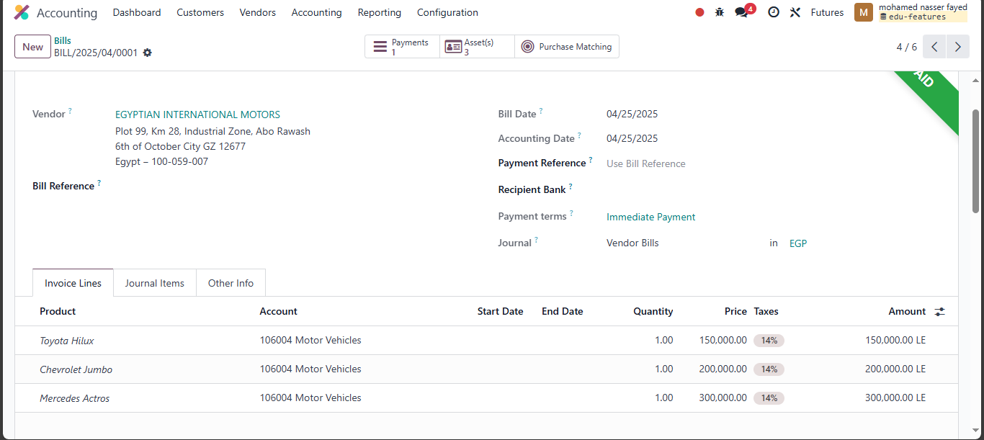
Assets

Slide 25
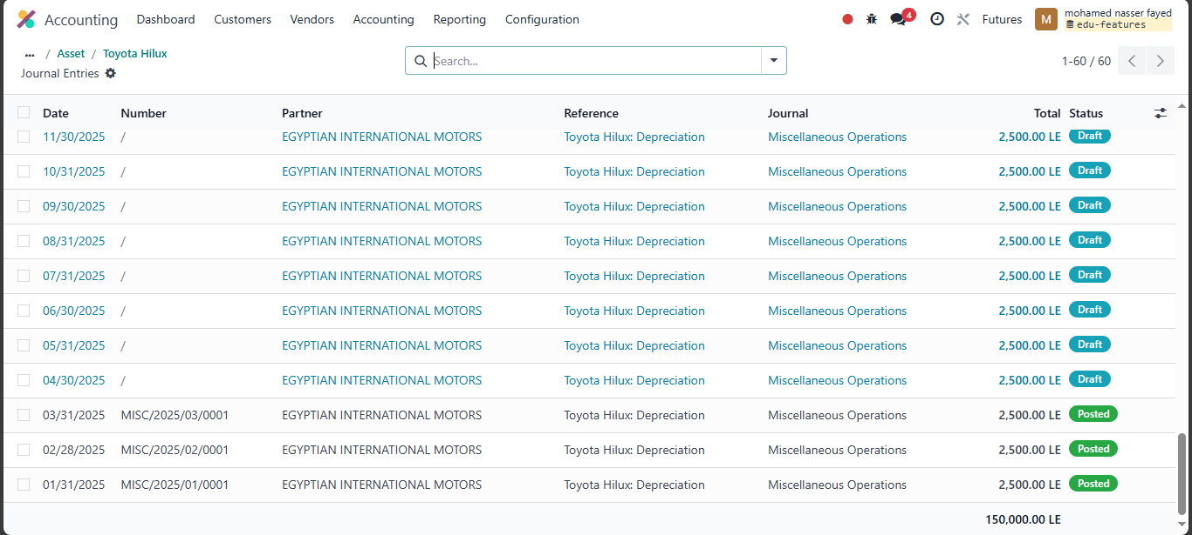
Assets

Slide 26
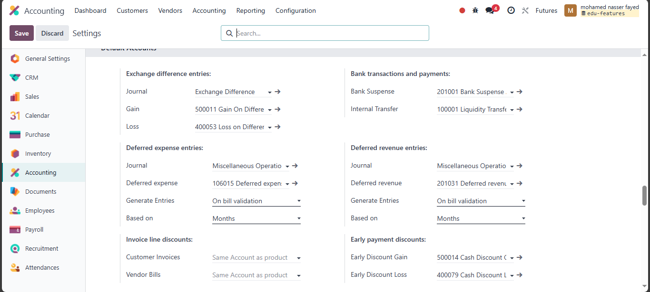
Deferred expense

Slide 27
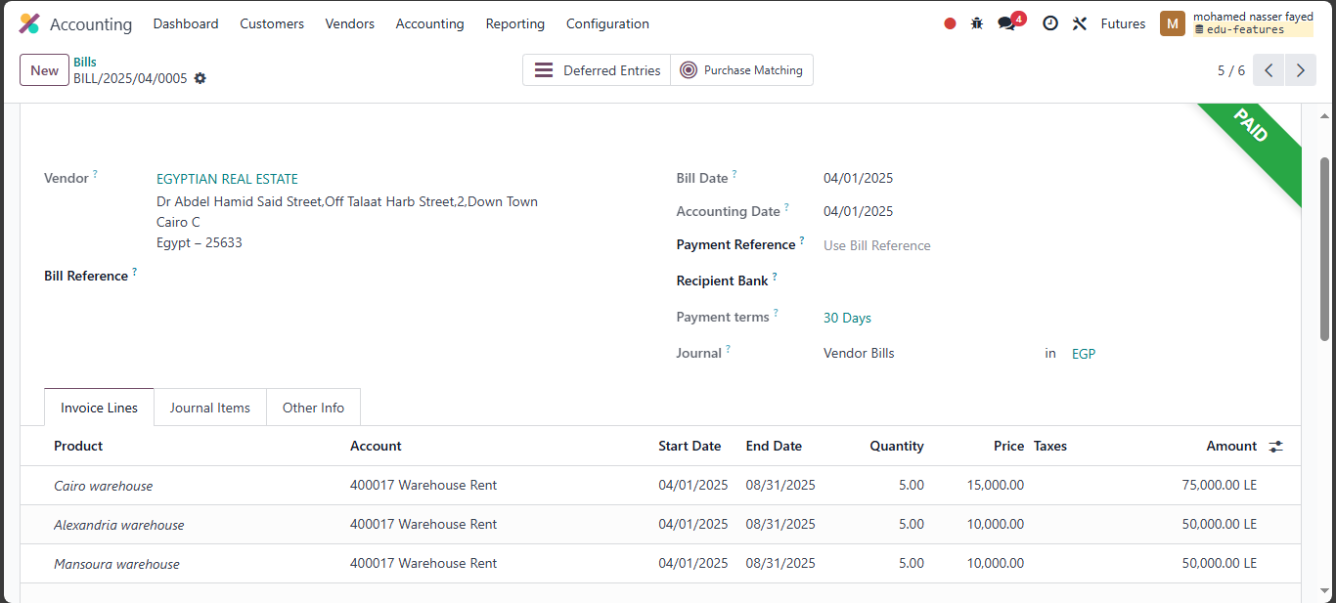
Deferred expense

Slide 28
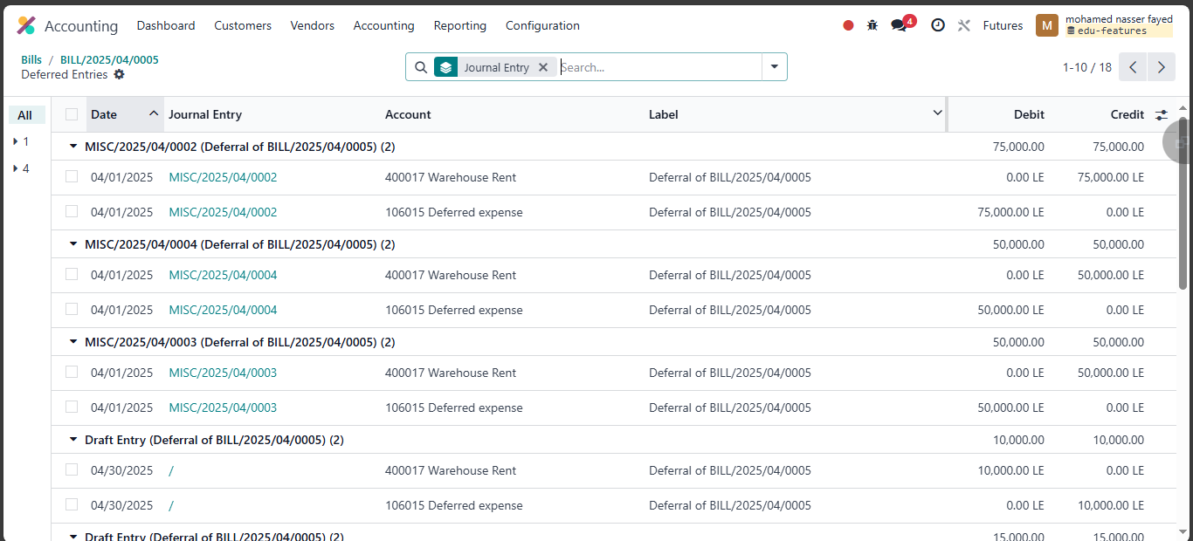
Deferred expense

Slide 29
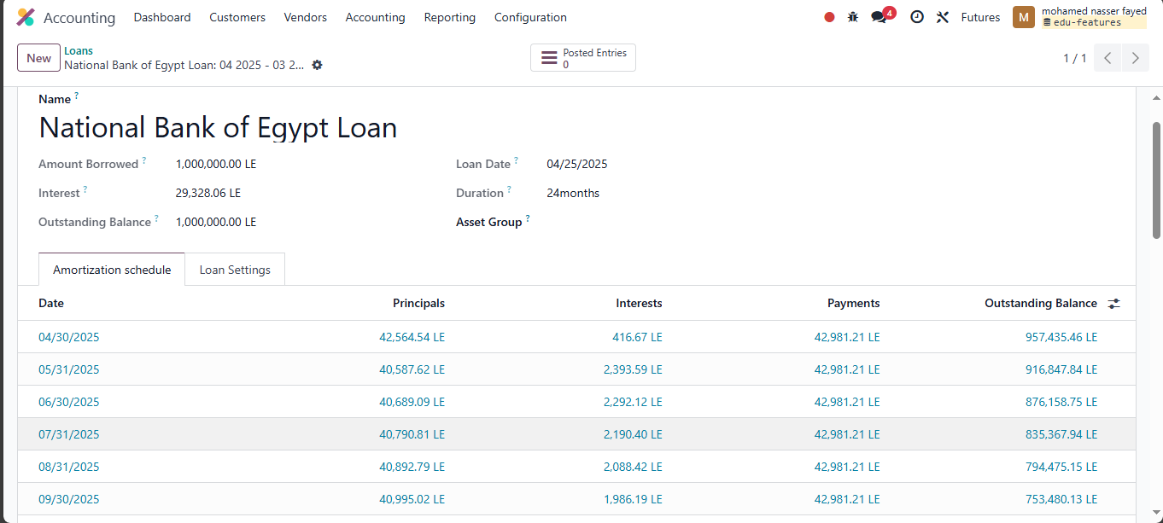
loans

Slide 30
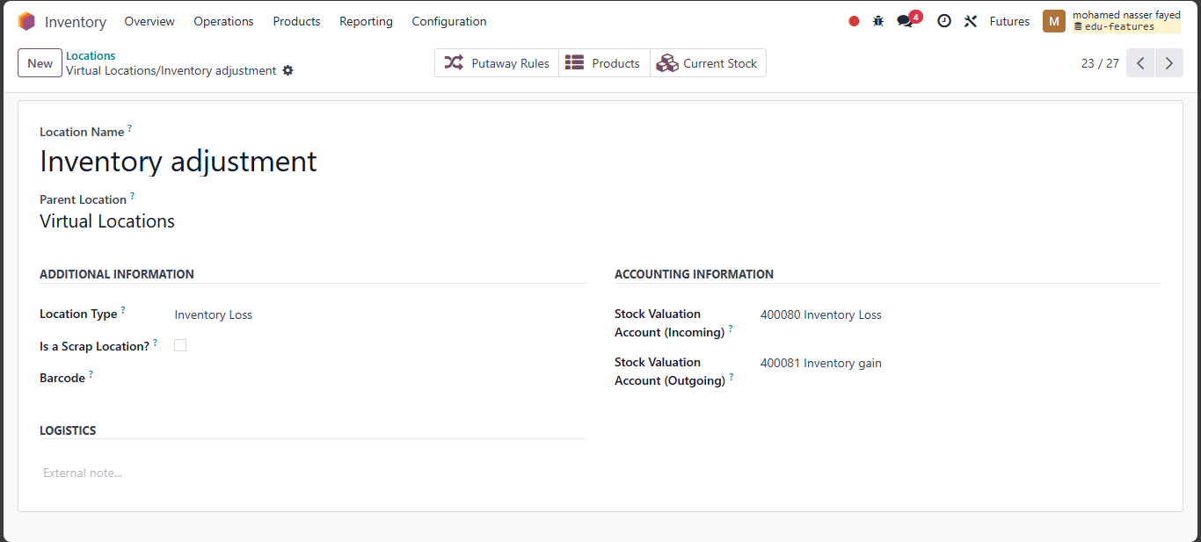
Inventory Acc

Slide 31
Inventory

Slide 32

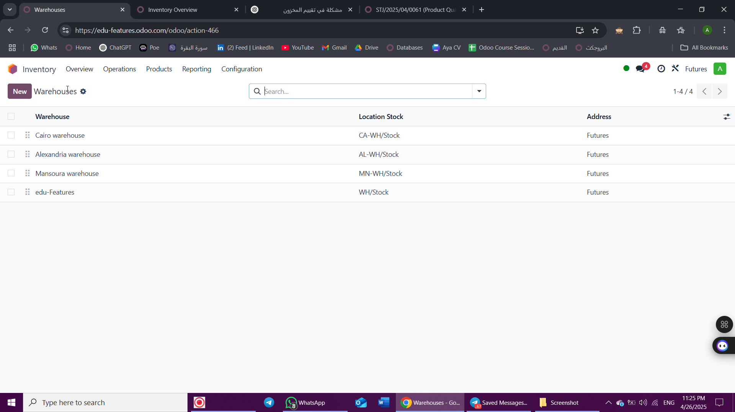
warehouses

Slide 33
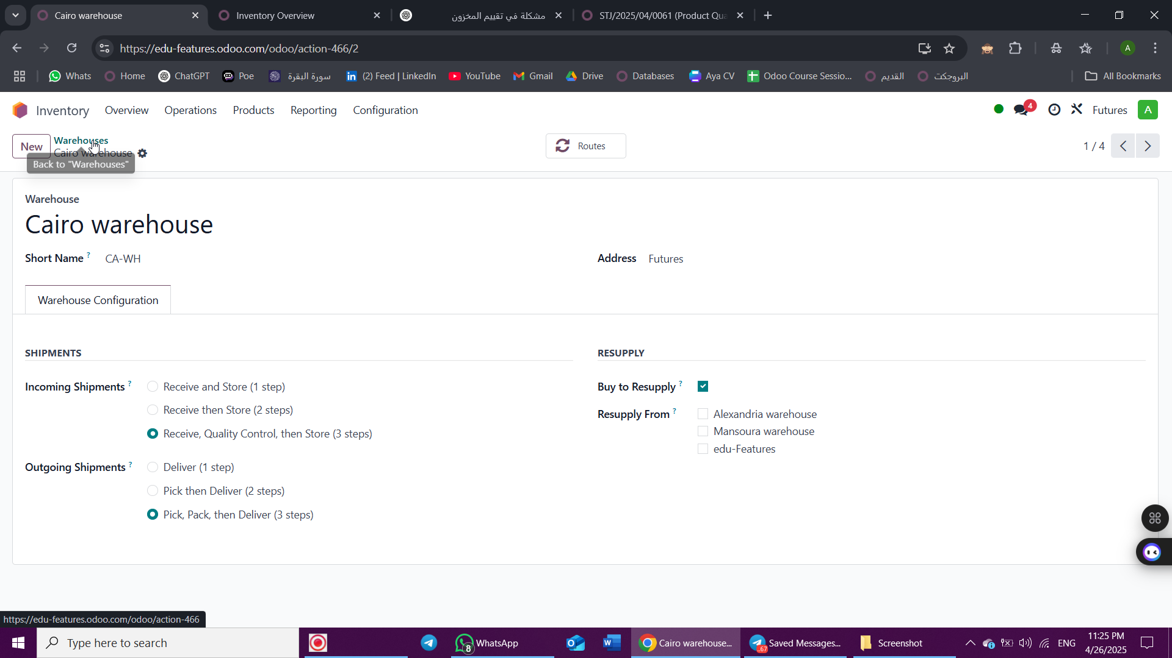
Main Warehouse

Slide 34
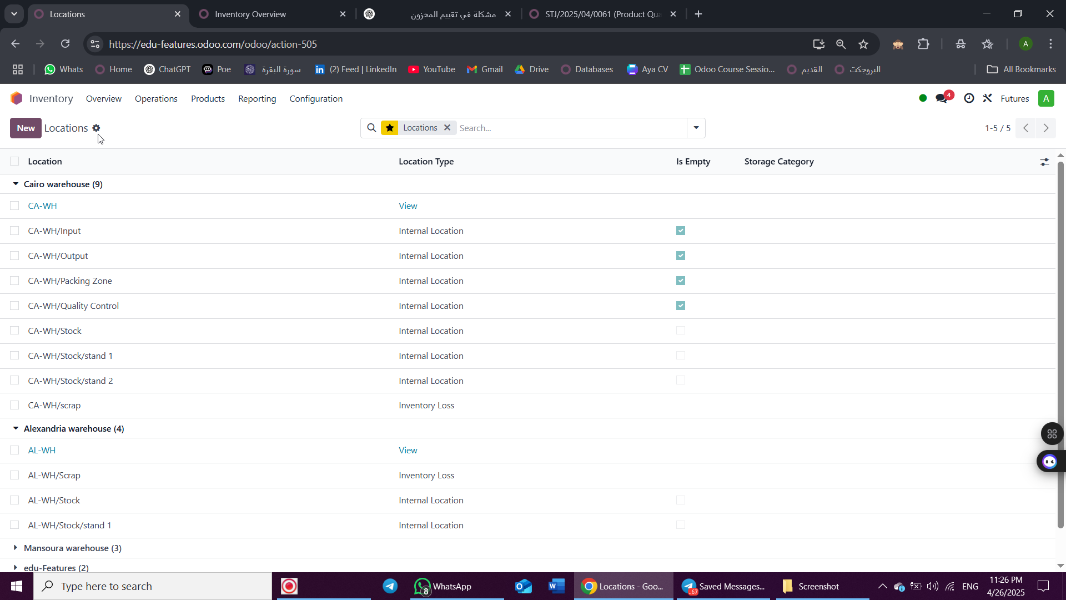
Locations

Slide 35
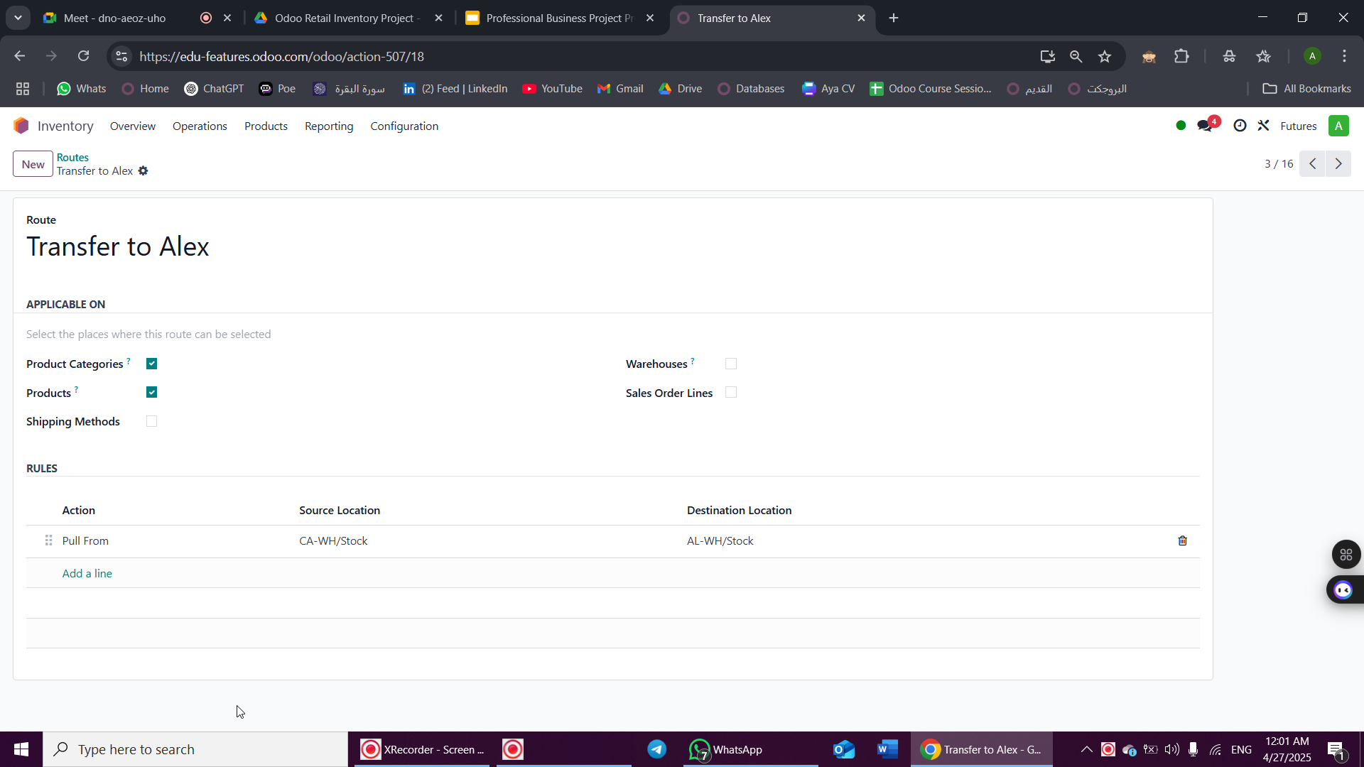
Routes

Slide 36
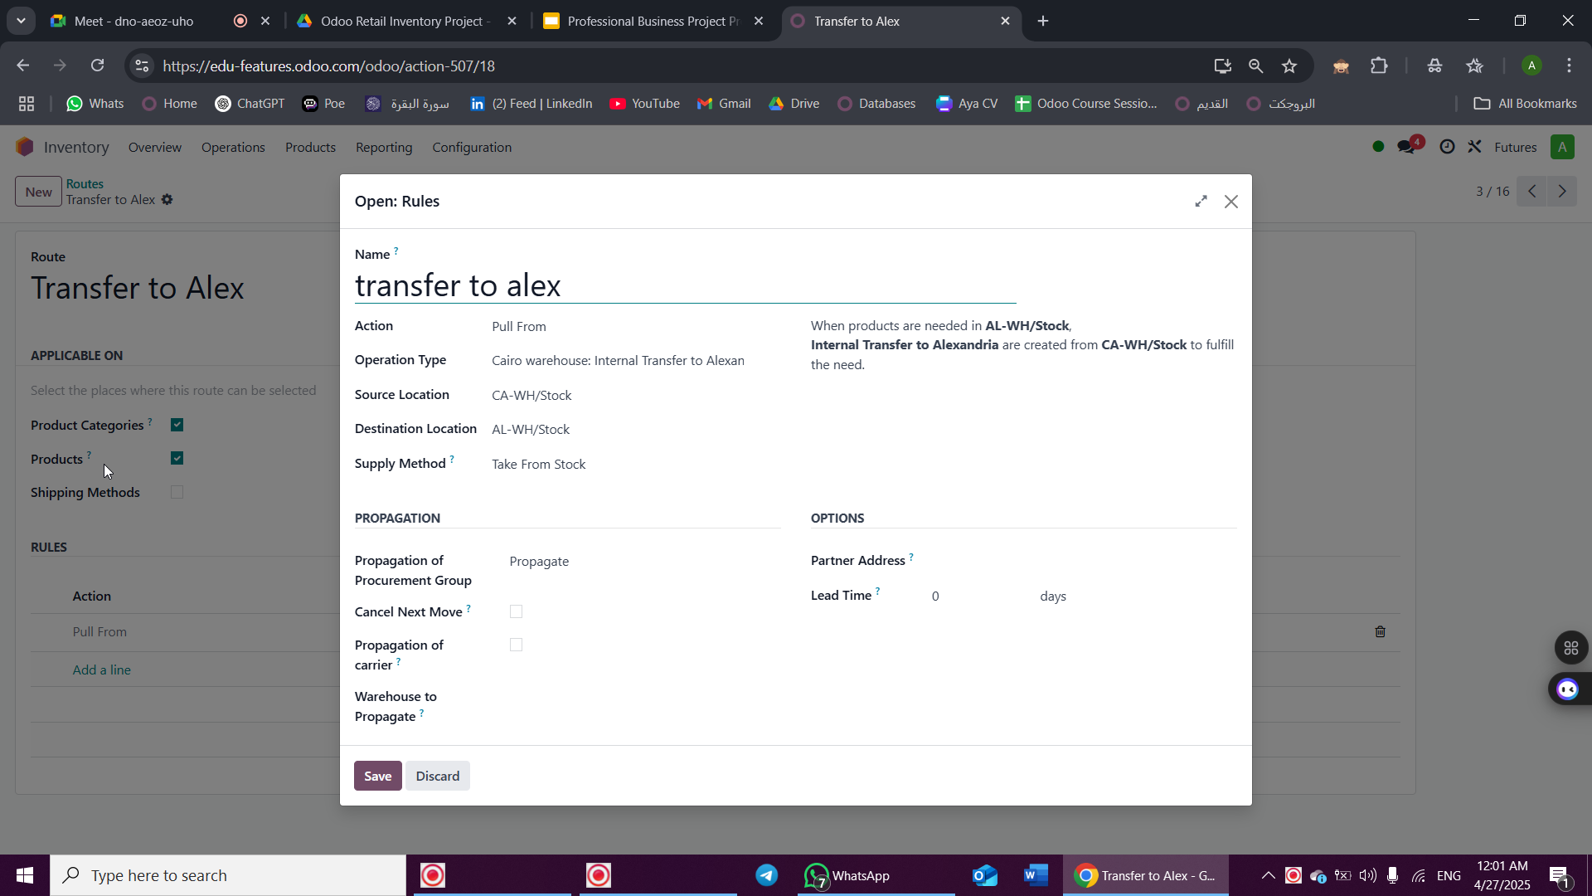
Operation Type

Slide 37
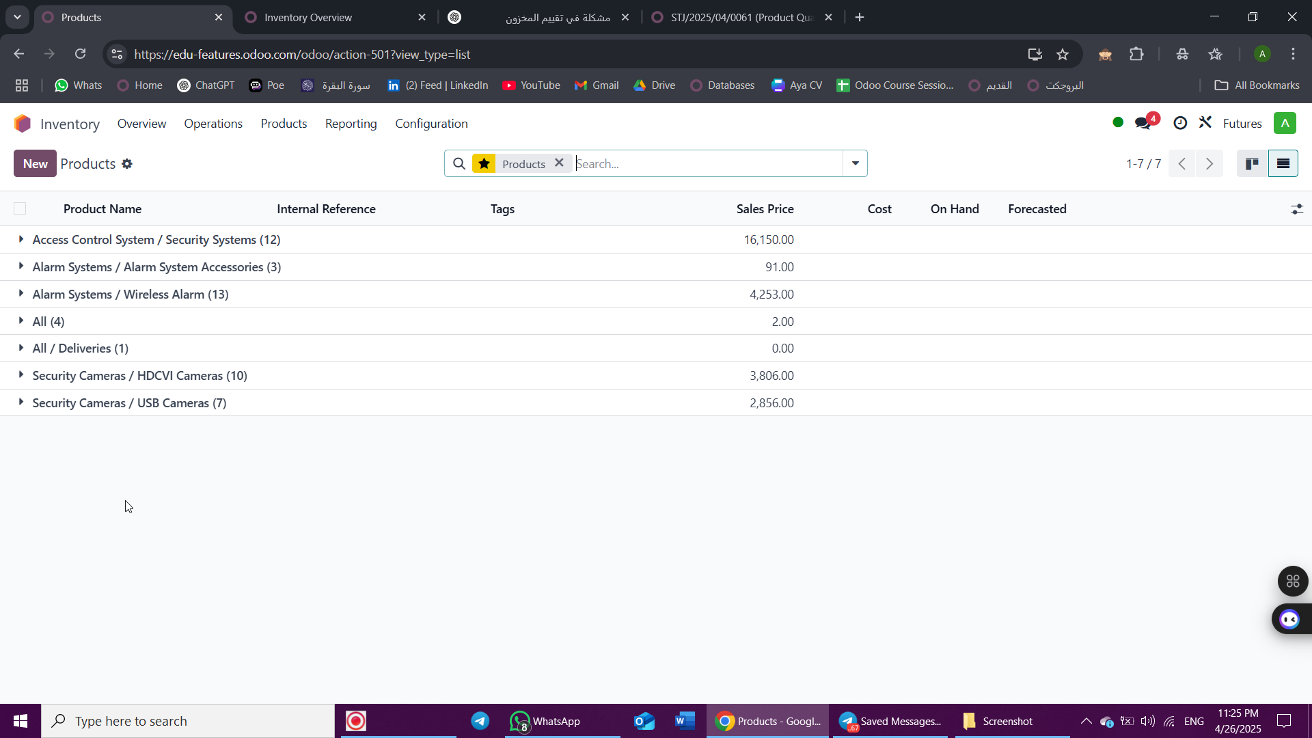
Product Category

Slide 38
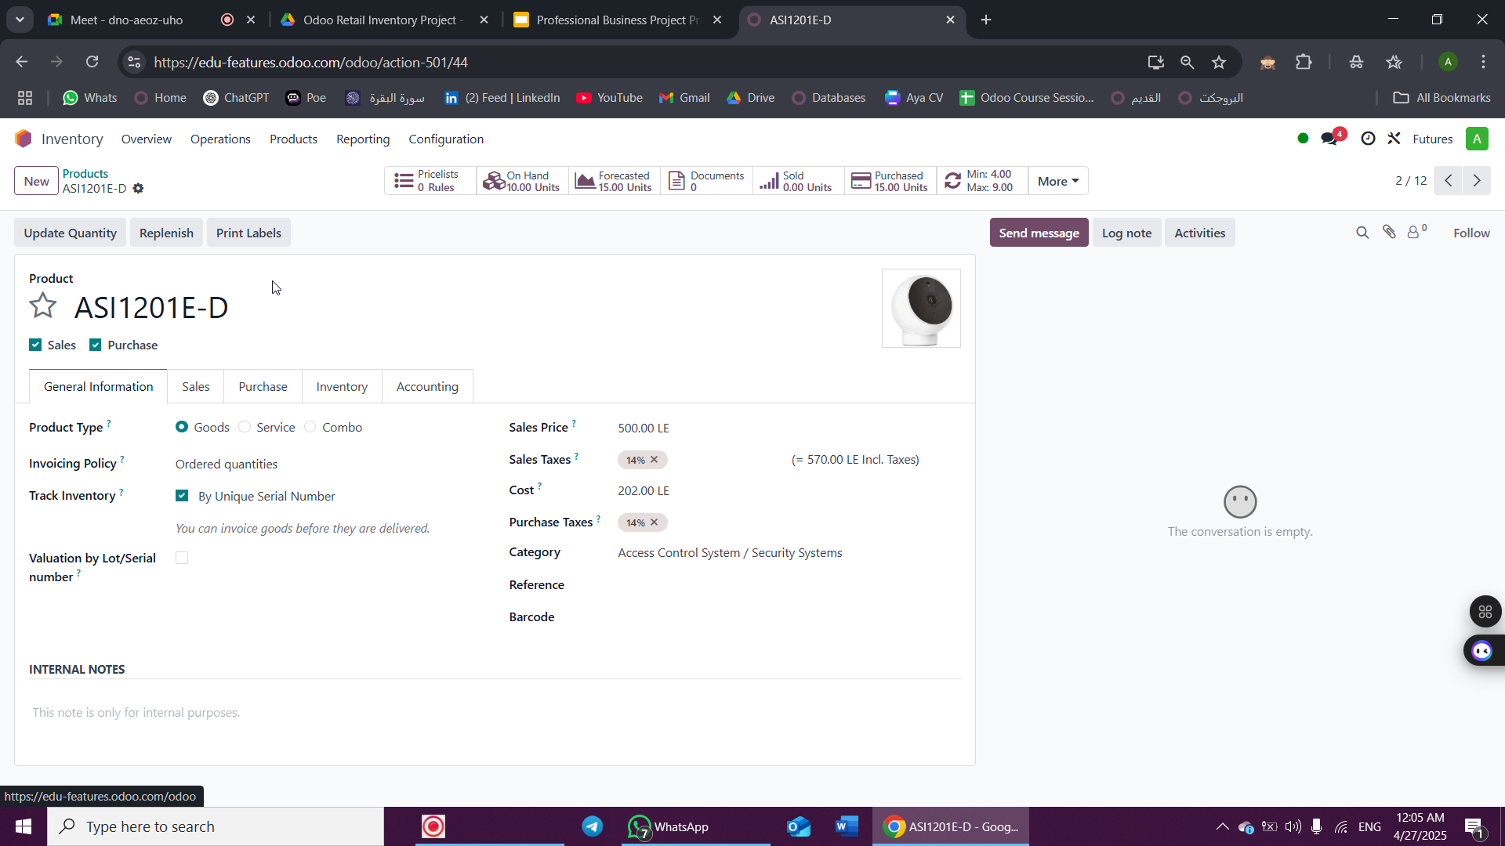
Product

Slide 39
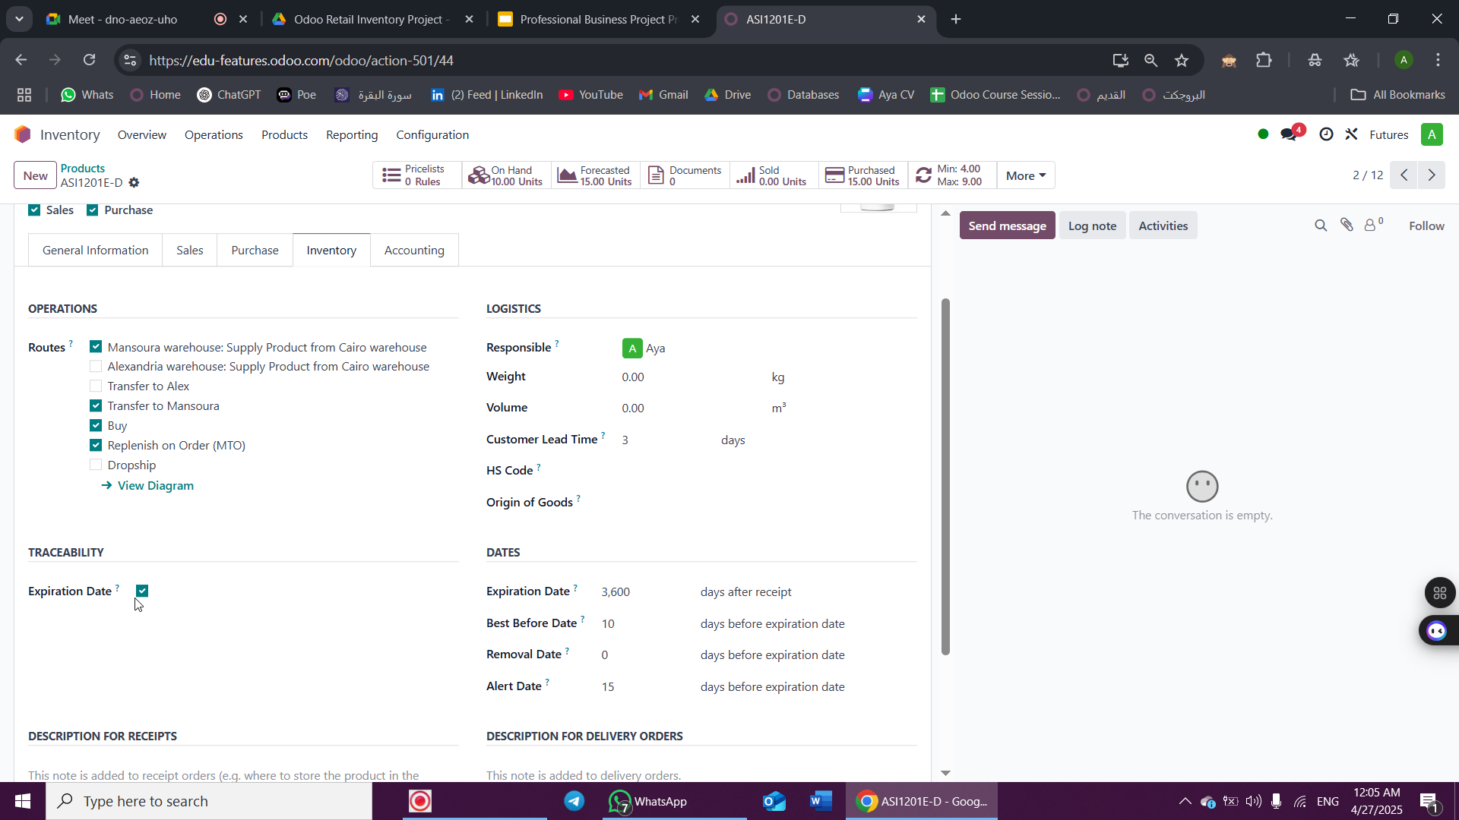
Product

Slide 40
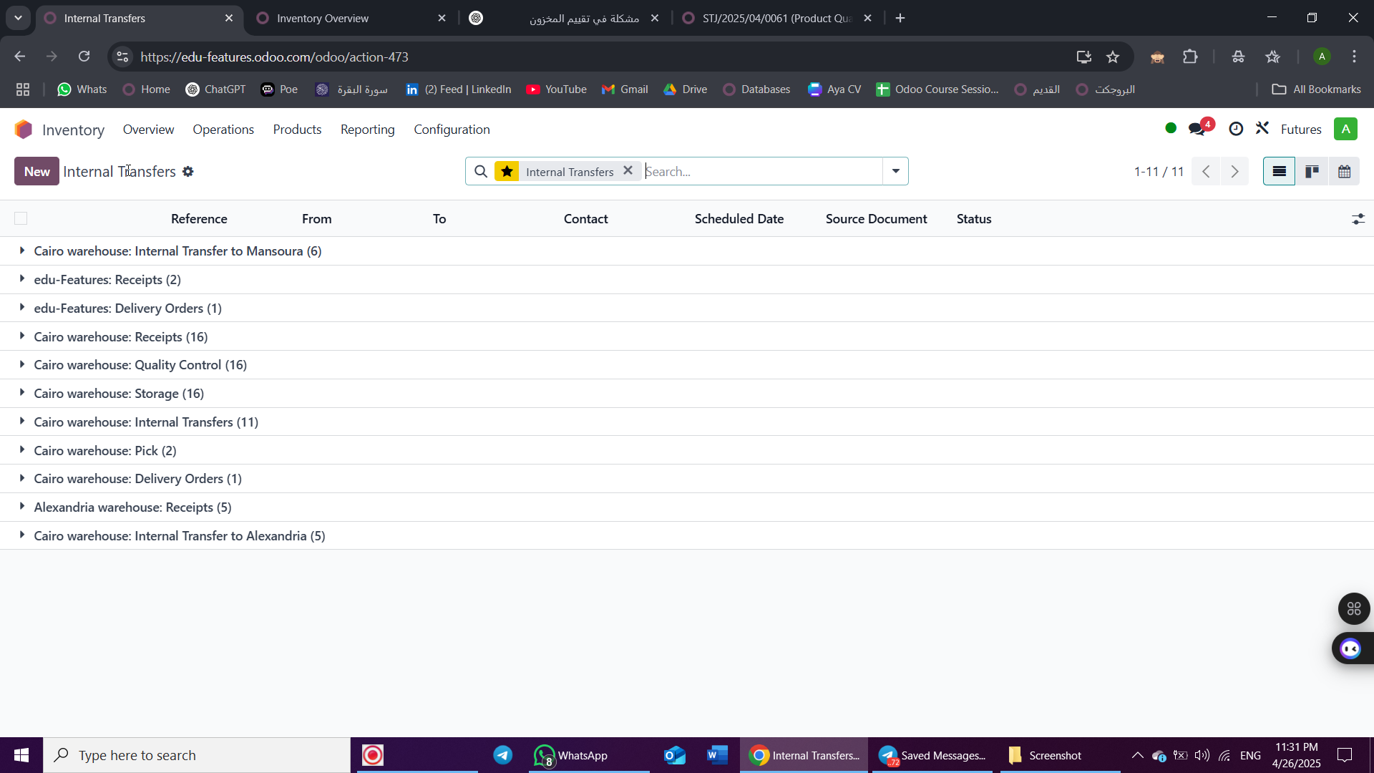
Internal Transfers

Slide 41
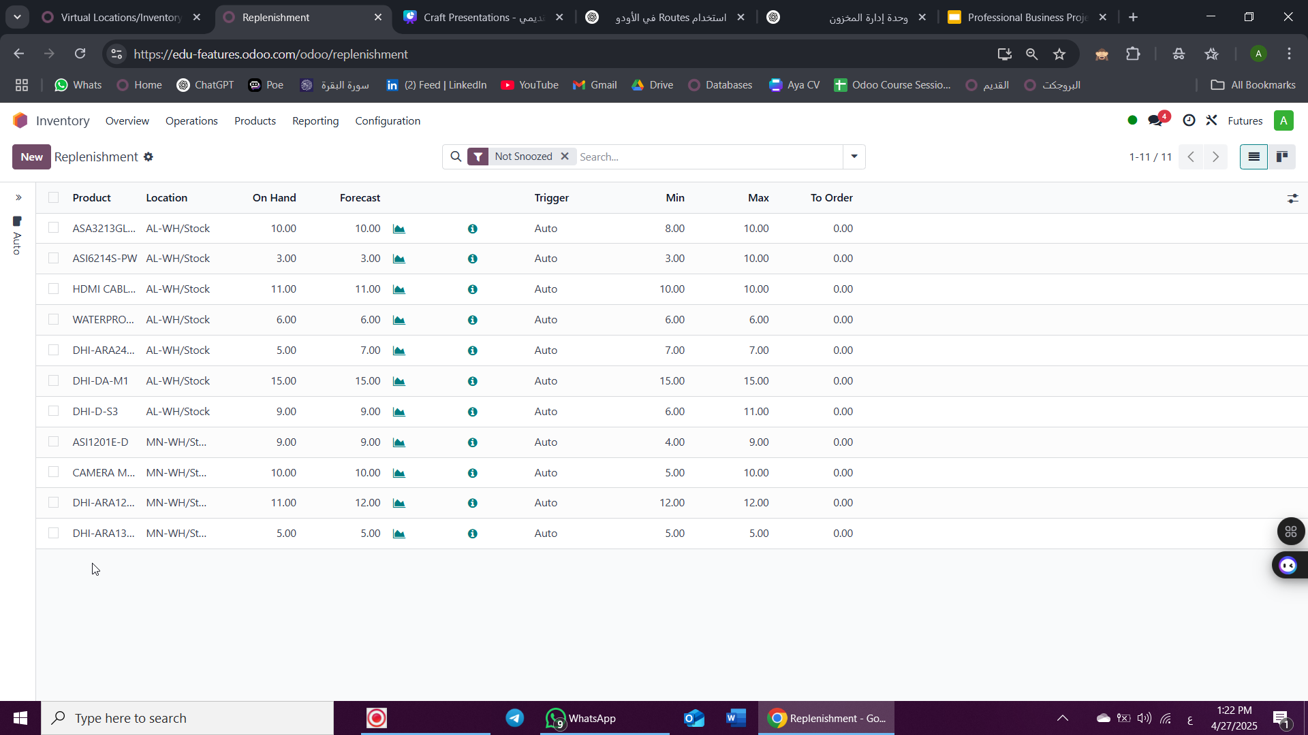
Replenshment

Slide 42
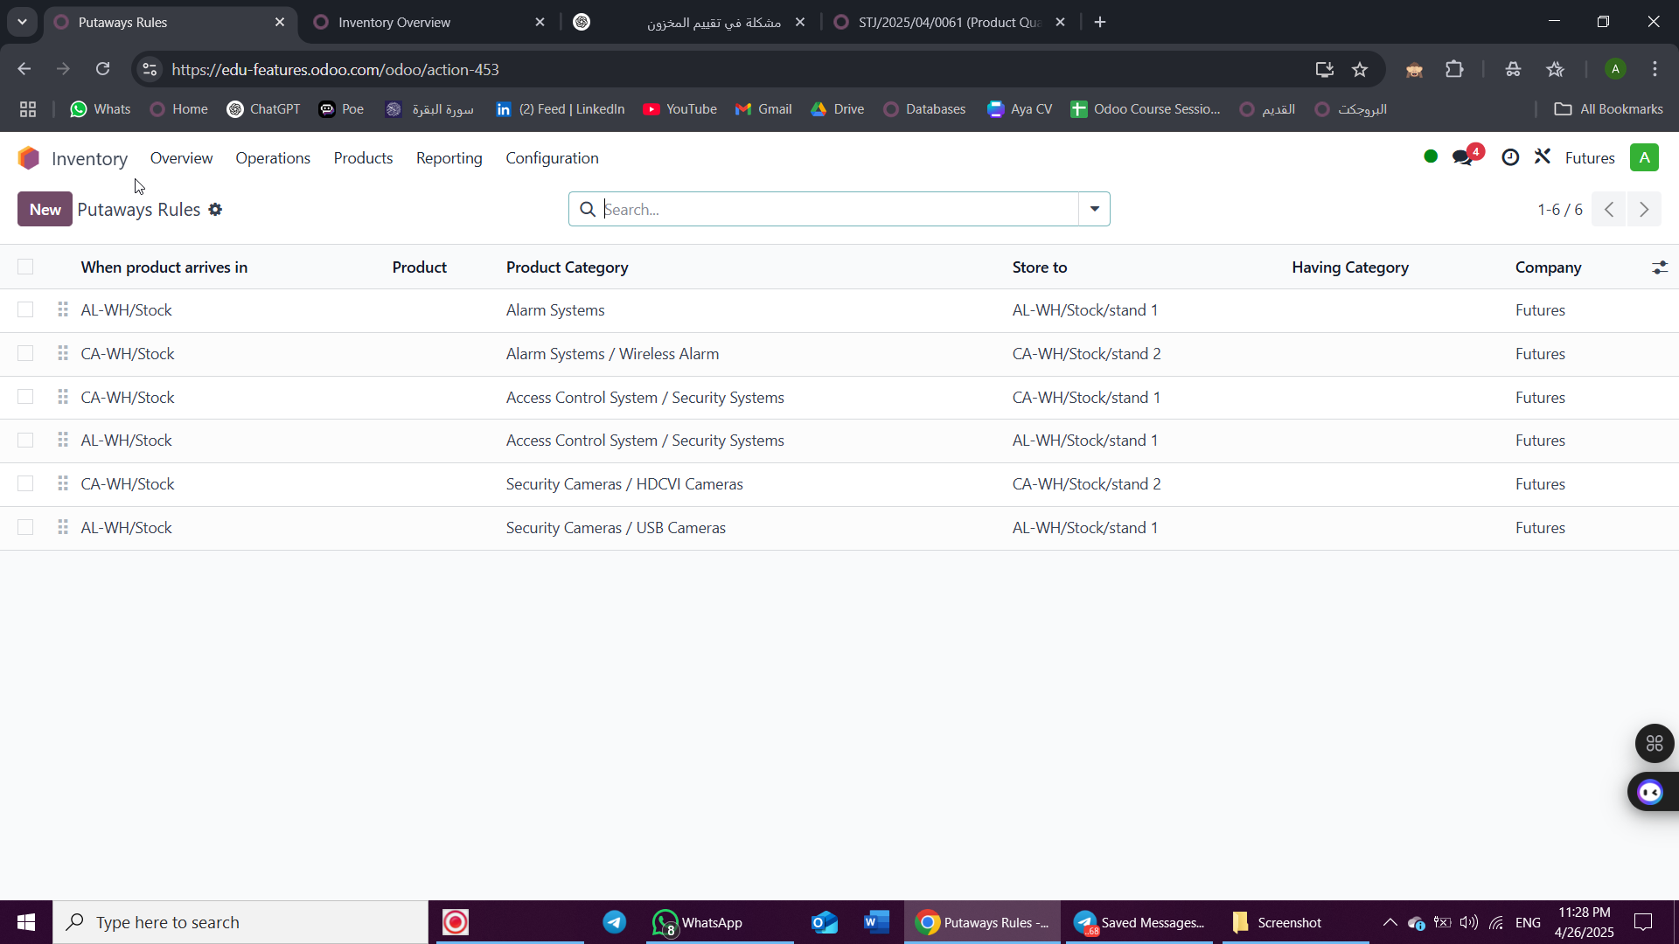
Putaways Rules

Slide 43
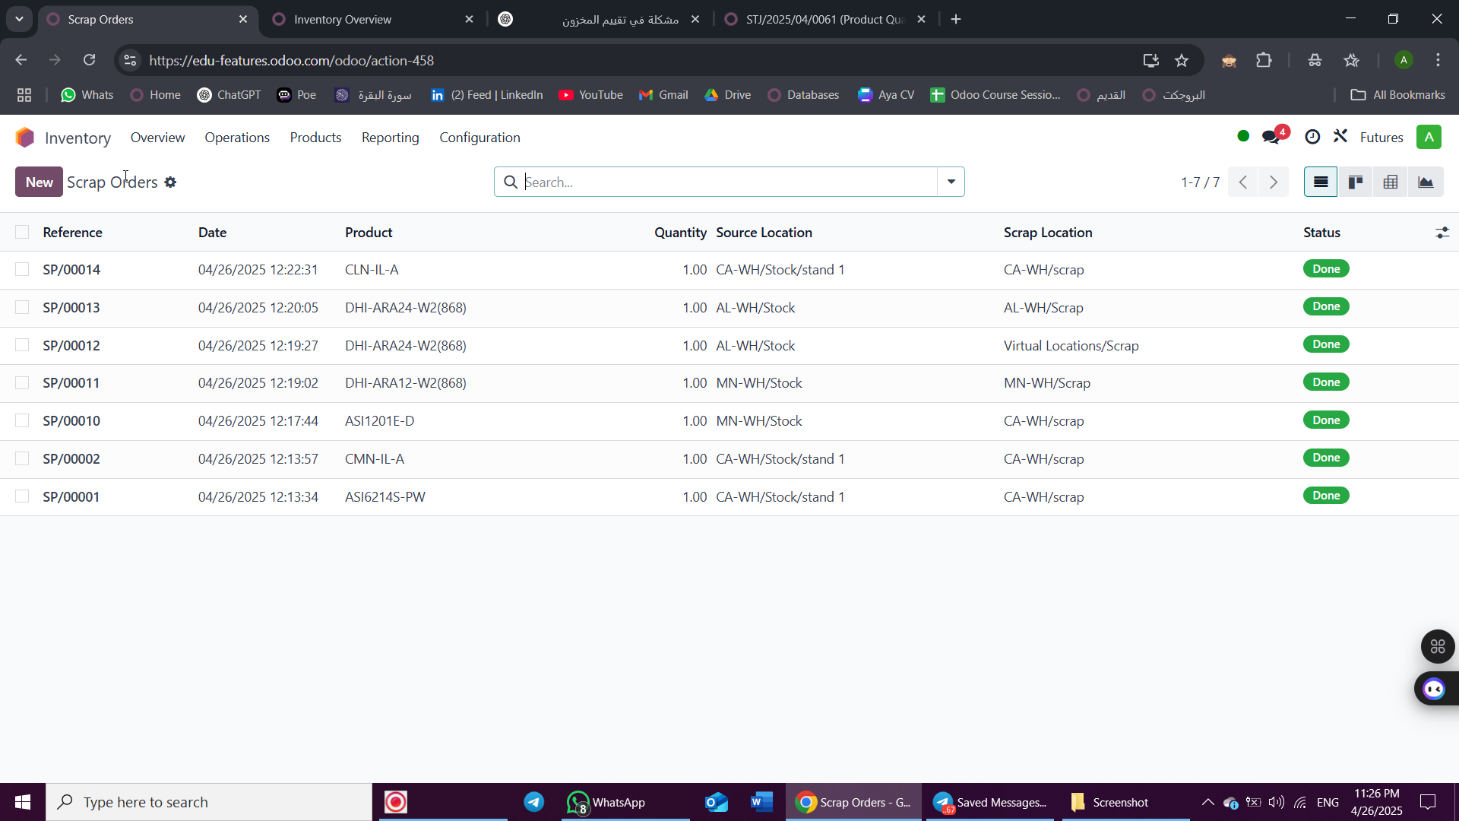
Scrap location

Slide 44
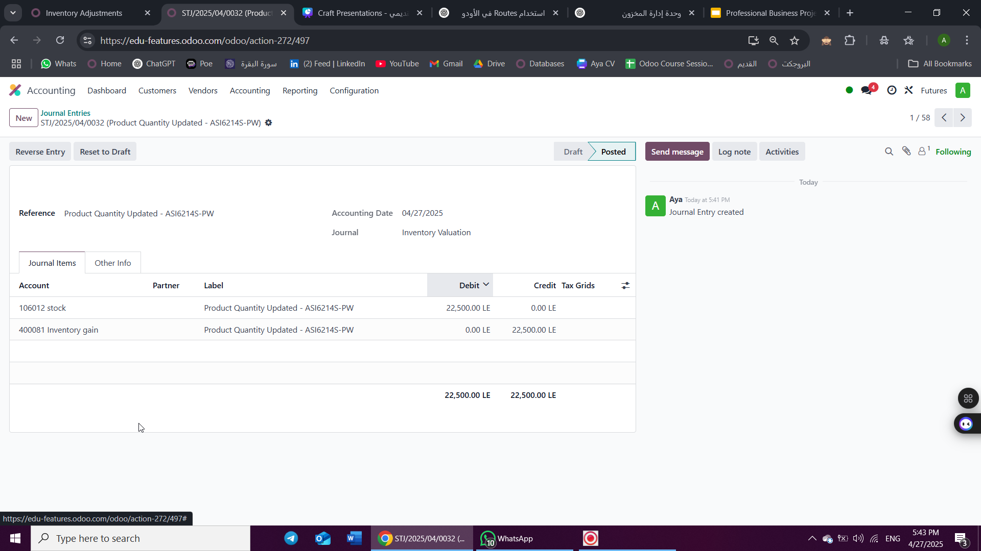
Inventory Adjustment

Slide 45
Purchases

Slide 46
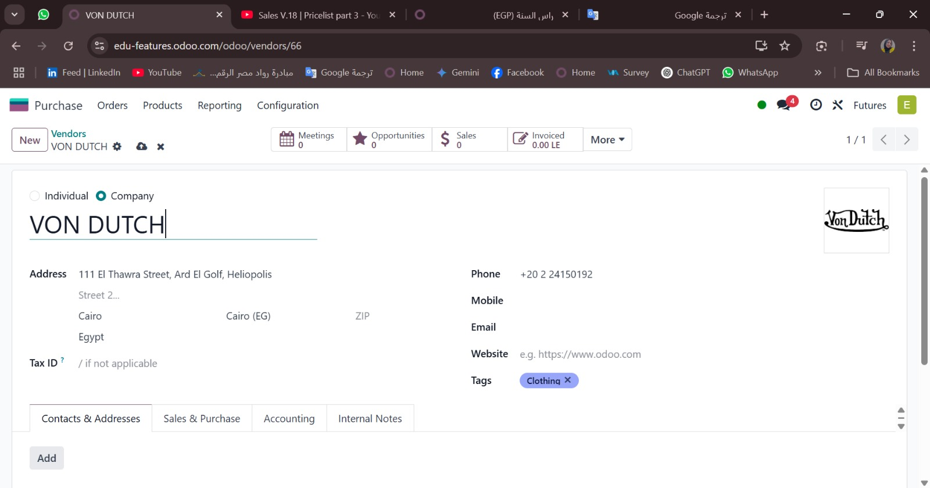
Vendor Creation

Slide 47
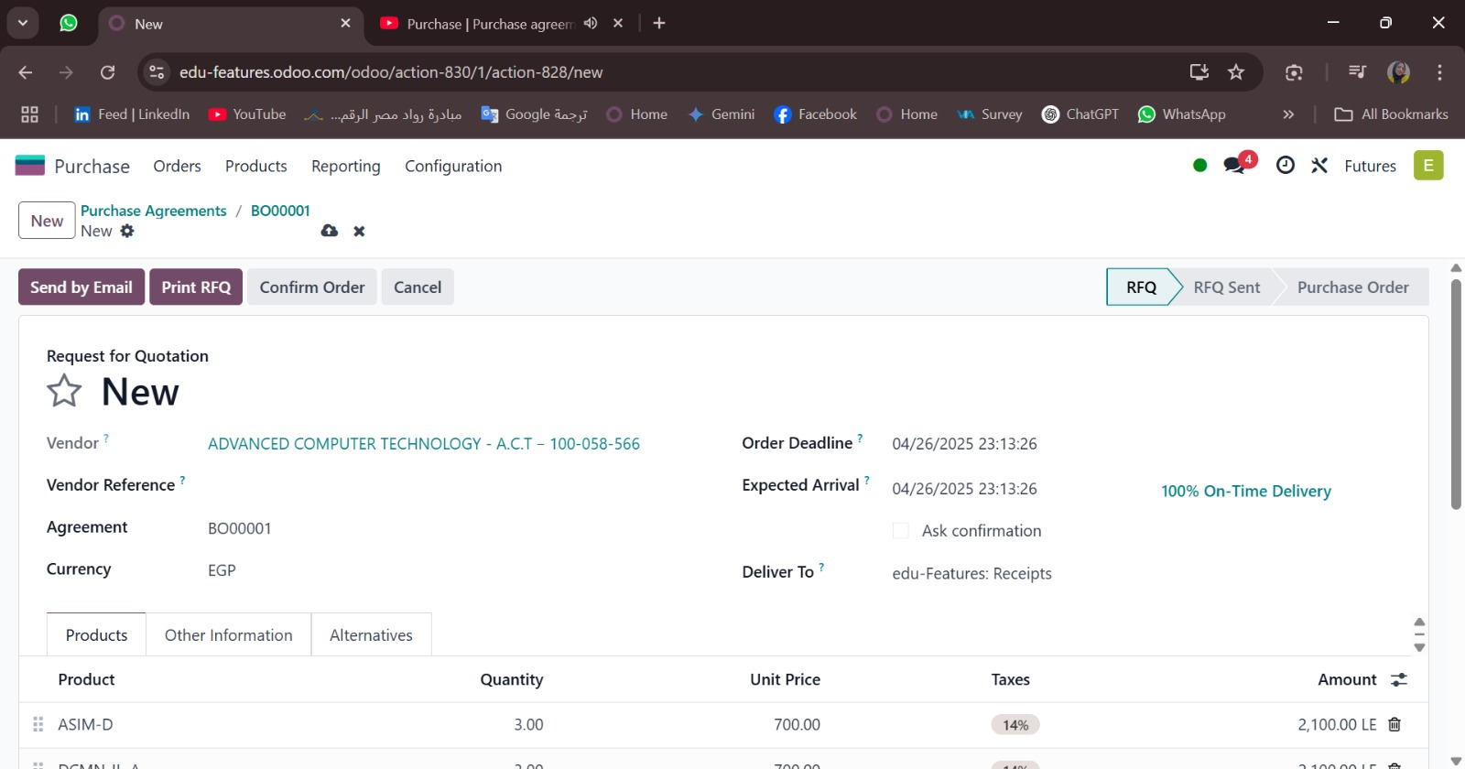
Purchase Agreements

Slide 48
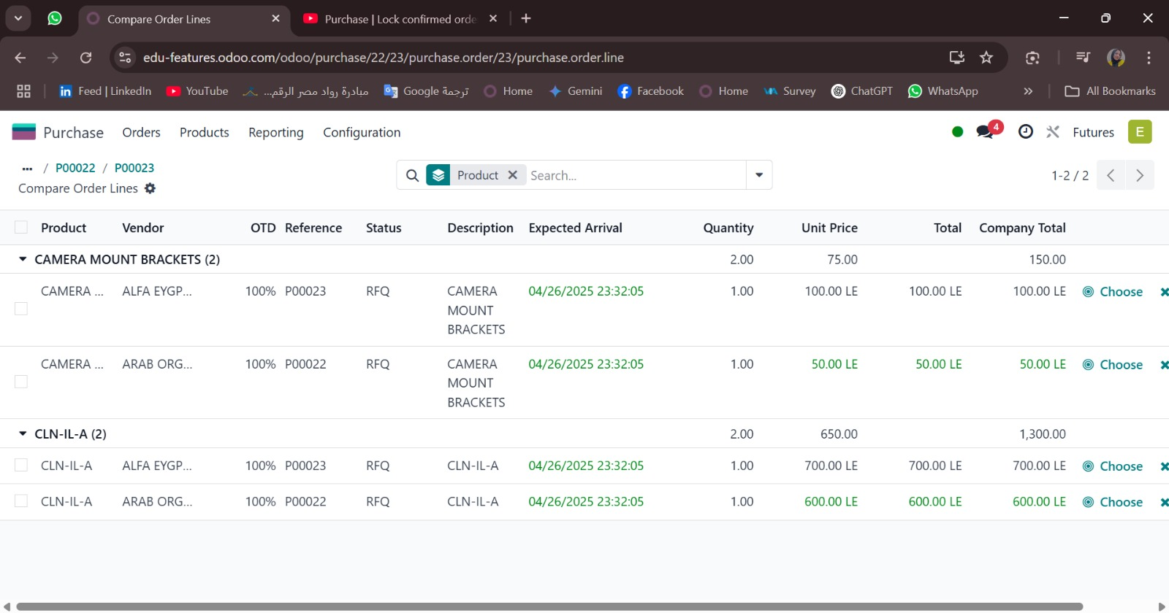
Alternatives

Slide 49
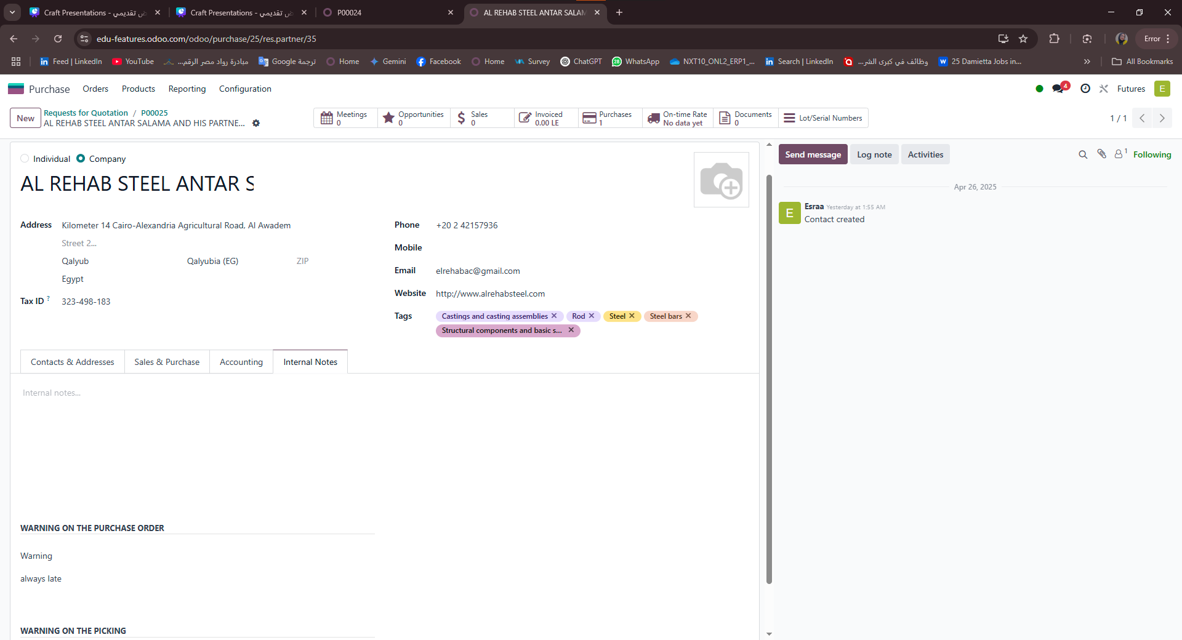
Warning

Slide 50
Sales

Slide 51
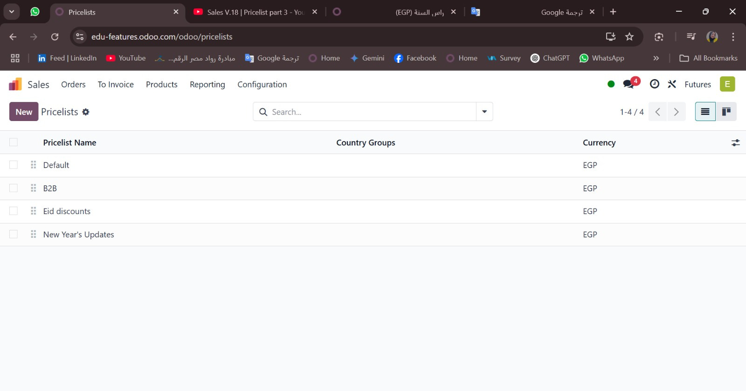
Pricelists

Slide 52
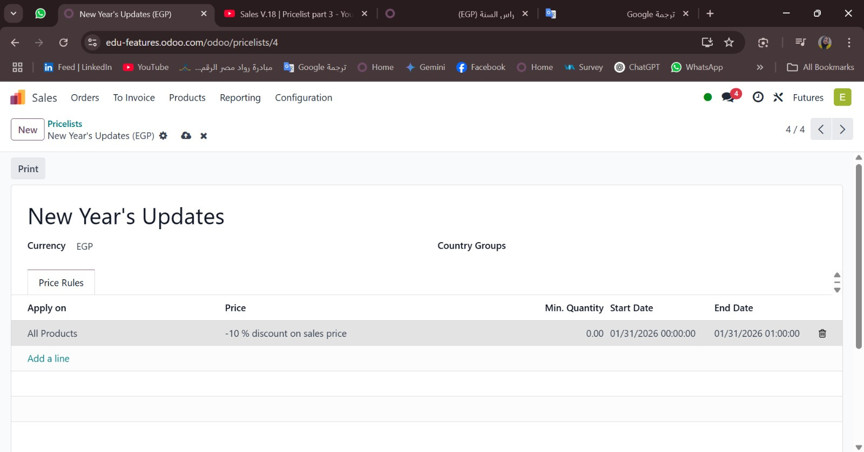
Pricelists

Slide 53
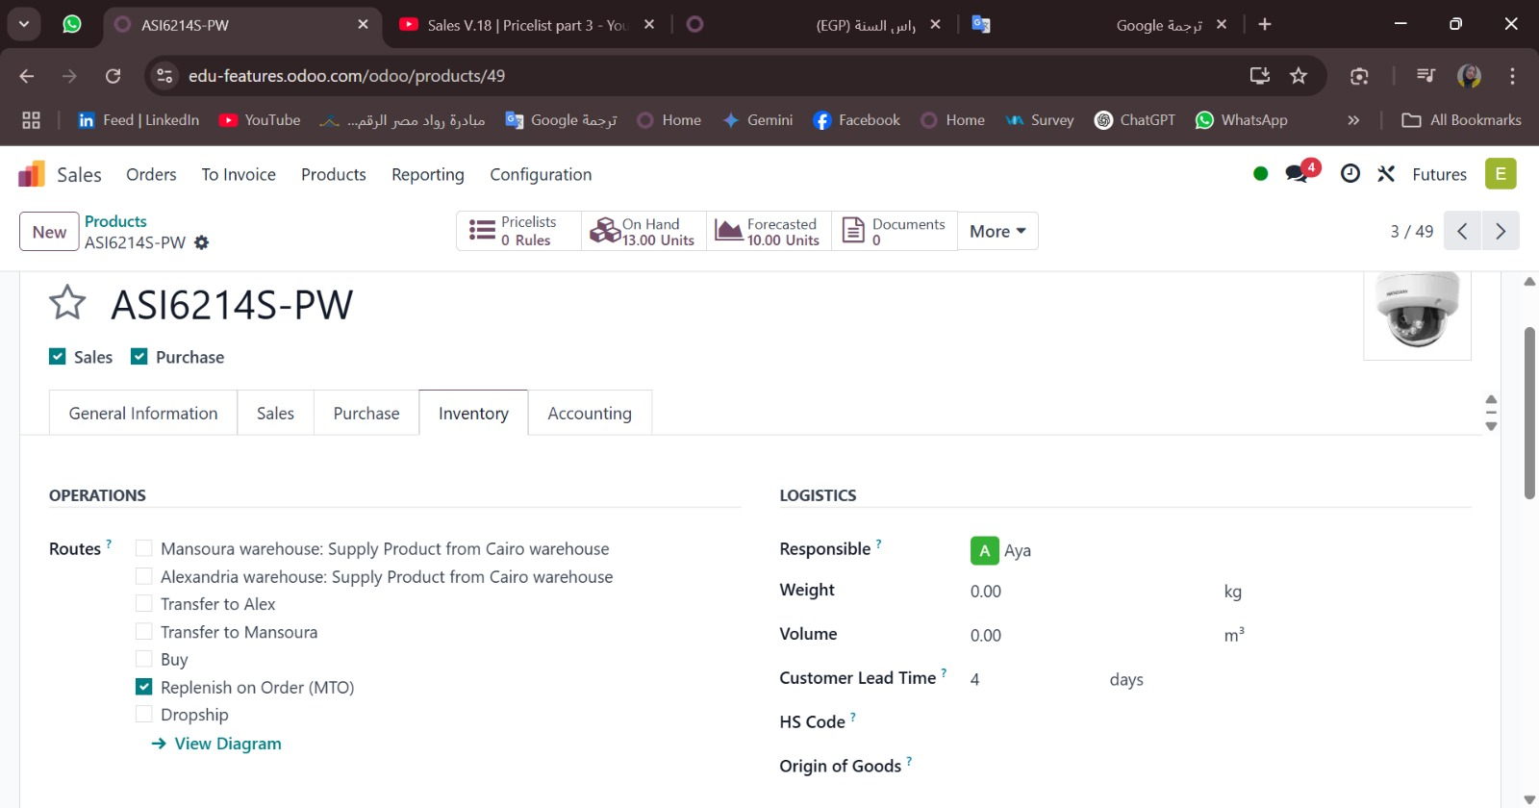
MTO

Slide 54
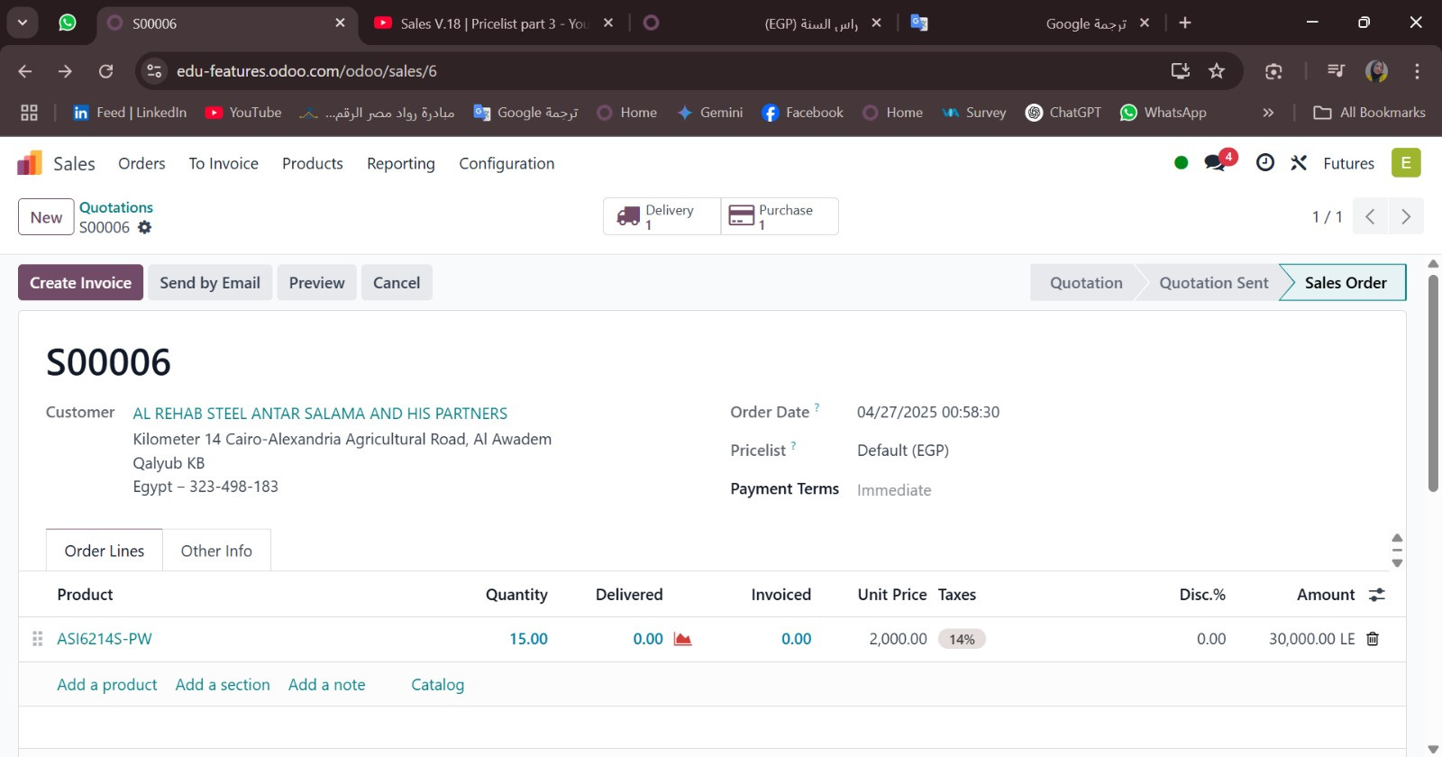
MTO

Slide 55
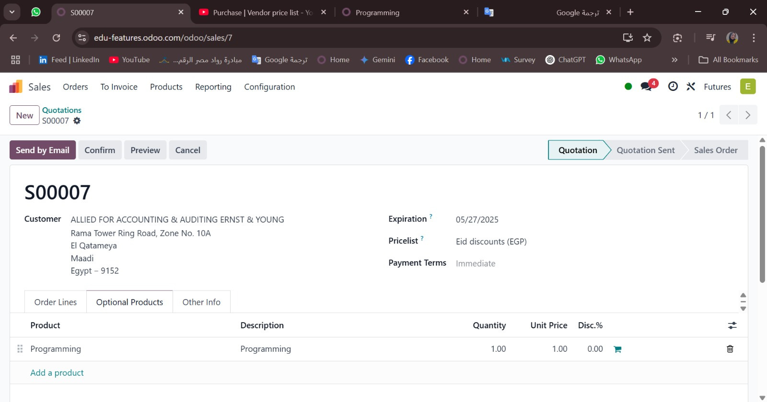
Optional Products

Slide 56
CRM

Slide 57
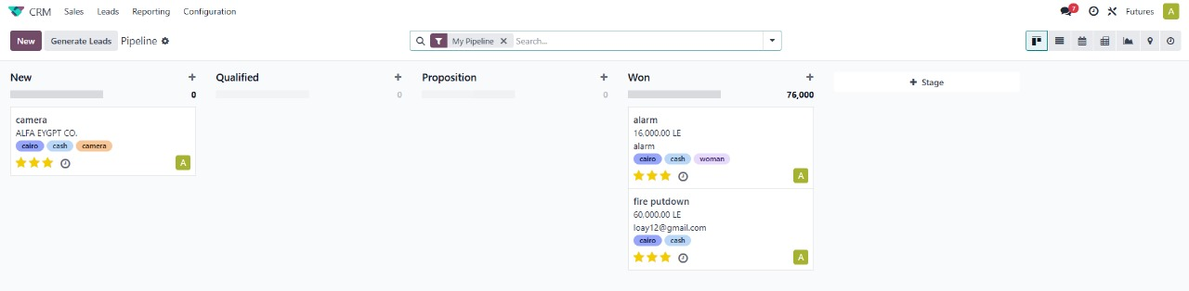
pipelines
Notes:
pipelines

Slide 58
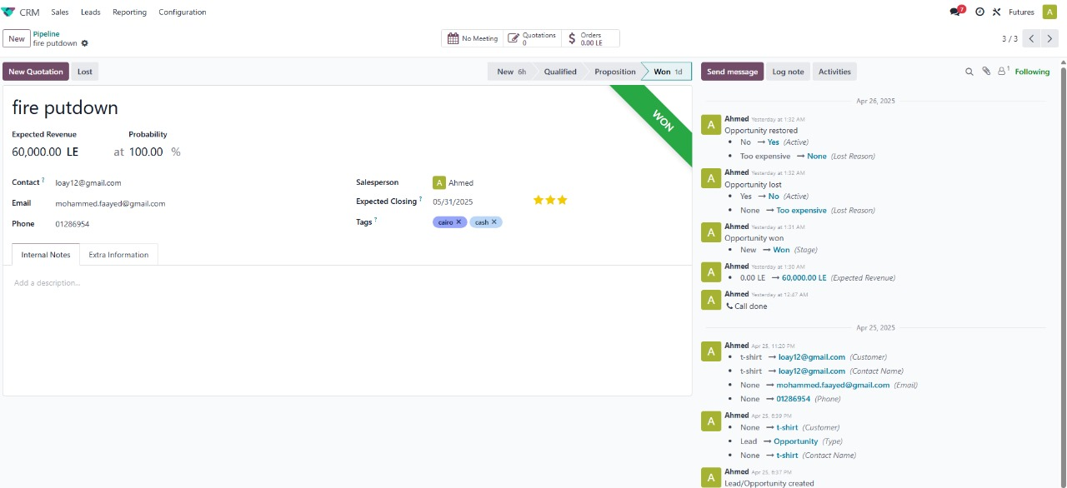
Example on pipeline and qutation

Slide 59
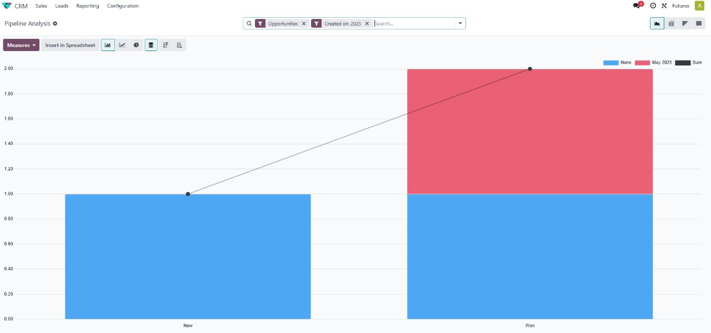
graphs and measures

Slide 60
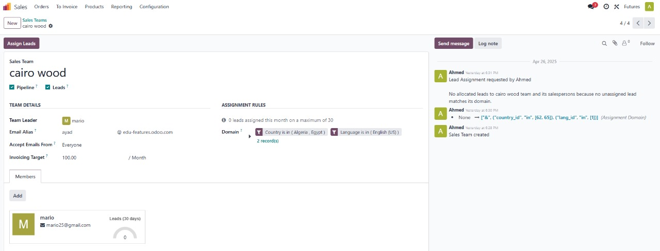
sales teams and domain

Slide 61

qutations

Slide 62

leads and convert to oppurtunity

Slide 63

important settings

Slide 64
HR

Slide 65


Job position
Recruitment stages

Slide 66

Employees

Slide 67

Contracts

Slide 68
Attendance

Slide 69

Time off

Slide 70
Thank You

